Slide 1
Functions

Slide 2
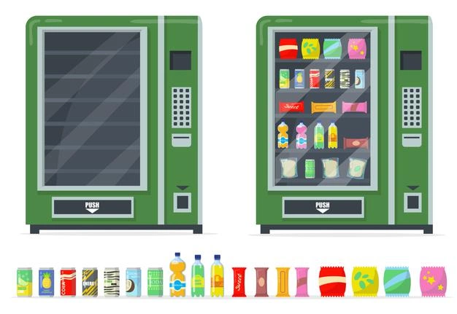
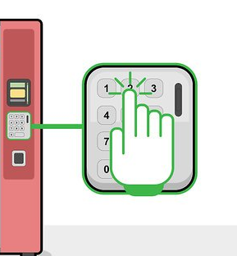
What is a Function?
A block of code that does things for you.
It takes in arguments (or inputs) and does something different depending on the arguments given.
getDrink(C1)
Vending machine example from Sharon Greenblum
Notes:
Vending machine: Like a function - put in an argument (C1), get a drink out!
Smoothie bot: A more complicated function but essentially the same. Order a drink and watch the robot go through its motions.

Slide 3
Why Use A Function?
Useful if you are going to need to do the same thing over and over
Remember to:
Write comments/document what your function is doing
Use explanatory argument names and function names (e.g. don’t name an argument “argument”)

Slide 4
Types of Functions
Built in
Exist in built in libraries
Created by developers
User-Defined
Created by YOU
Exists locally in program
Examples include: Calculate_Area(), Print_Name()

Slide 5

Common Python built-in functions
print()
len()
type()
max()
min()
.upper()
.lower()

Slide 6
How to call a function
functionName(argument 1, argument 2, …)
Examples:
Code | Output
print(“Hello World”) | Hello World
max(10, 5, 17) | 17

Slide 7
In notebook 01_functions, complete the following section:
1 - Built-in Functions

Slide 8
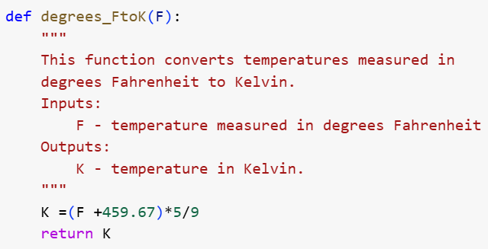
Defining Functions
def functionName(arguments):
lines of code
return output
Notes:
Functions don’t necessarily need to return anything

Slide 9
Defining Functions
What is the name of the function?
What does the function do?
What argument does the function take in?
What does the function return?
Notes:
Note how the comments are really useful to understand what the function does and what inputs/outputs it has!

Slide 10
Defining Functions
Let’s say you wanted to convert 80 Fahrenheit to Kelvin.
How would you call the function?

Slide 11
Defining Functions
You can also store the returned value from the function in a variable:
temp = degrees_FtoK(80)
print(temp)
Notes:
The main difference between return and print is that return returns a value while print doesn’t return a value

Slide 12
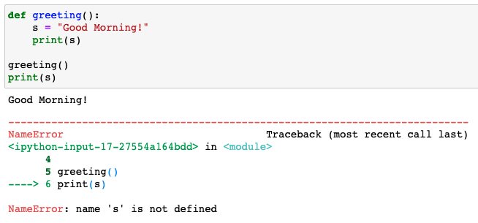
Local vs. Global Variables
Local variables:
If you declare a variable inside the function, it only belongs to that function

Slide 13
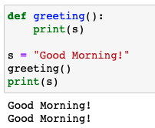
Local vs. Global Variables
Global variables:
Defined outside of functions and are accessible throughout the program (both inside and outside of functions)

Slide 14
Importing libraries/modules
Modules and libraries can contain functions and variables you may need to use in your code
Import math: has many math functions (pi, sin, …)
Import numpy: important module for data science (makes arrays, statistical analysis, …)
Once you import something, you can use it throughout the notebook
import _____ as __
import numpy as np

Slide 15
In notebook 01_functions, complete the following section:
2 - Defining Functions
3 - Importing Libraries
When you are done, complete the Exit Ticket!
If you have extra time, you can try the challenge.

